Slide 1
Analyzing App Success in the Google Play Store
An SQL-Driven Exploration of Key Metrics

Slide 2
DATASET OVERVIEW :
Key features -The data set has (10842 rows, 13 columns)
Scope of Dataset – The dataset used in this study was created through web scraping and may not reflect the current scenario accurately.

Slide 3
Data Cleaning
Initially, the dataset contained 10,842 rows and 13 columns, but it was highly impure. After importing the data into MySQL, only 381 rows and 13 columns were imported. After cleaning the data using Python, the dataset was reduced to 9,360 rows. This cleaned dataset, still with 13 columns, was then loaded into MySQL locally.

Slide 4
Purpose of the project :
The purpose of this project is two fold.
The primary aim of this project is to explore the factors influencing app
success on the Google Play Store.
We aim to identify trends and patterns in app performance based on various
attributes such as category, rating, number of installs, and more.
2. To demonstrate the practical application of SQL in analyzing real-world data.

Slide 5
SQL FUNCTIONS USED :
Basic SQL Operations - SELECT, FROM, WHERE, GROUP BY, SET
Advanced Querying and Filtering - AND, OR ,NOT ,IN ,CASE statement, Subquery
Ordering and Limiting Results - ORDER BY ,LIMIT
Aggregation Functions - SUM, AVG,COUNT
Joining Tables - INNER JOIN , SELF JOIN
Advanced SQL Concepts - CTEs (Common Table Expressions), Procedures, Functions
Data Transformation - Round, LOCATE, SUBSTRING

Slide 6
1. Identifying the Most Promising Categories for Launching New Free Apps
Objective: Pinpoint the top 5 categories for launching new free apps based on their average ratings.
Result: Events (4.44) , Eduaction (4.38) , Art & Design (4.36) , Books and Refrence (4.35) , Parenting (4.34)
These categories offer significant potential for launching new free apps due to their high average ratings. By targeting these top-rated categories, the company can leverage user satisfaction and positive reception to enhance app visibility and user engagement.

Slide 7
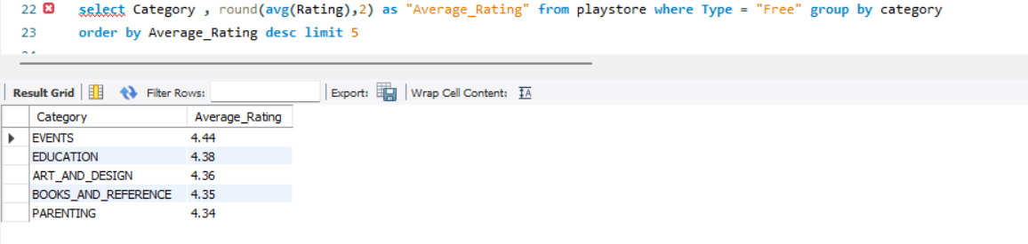
1-You're working as a market analyst for a mobile app development company. Your task is to identify the most promising categories (TOP 5) for launching new free apps based on their average ratings..

Slide 8
2. Top Revenue-Generating Categories for Paid Apps
Objective : Pinpoint the top 3 categories that generate the most revenue from paid apps. This calculation is based on the product of the app price and its number of installations.
Result :
Lifestyle : $3,199,340.56
Finance : $1,979,115.38
3.Photography : $1,162,143.33 These categories are the most lucrative for paid apps, demonstrating significant revenue generation. Focusing on these categories could maximize financial returns and capitalize on market demand for paid applications.

Slide 9
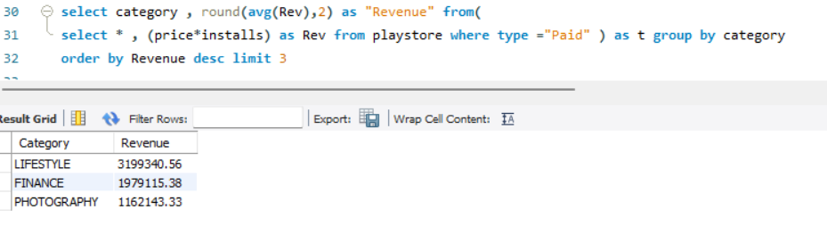
2- As a business strategist for a mobile app company, your objective is to pinpoint the three categories that generate the most revenue from paid apps. This calculation is based on the product of the app price and its number of installations.

Slide 10
3. Distribution of Gaming Apps Across Different Categories
Objective : Calculate the percentage of games within each category to help the company understand the distribution of gaming apps.
Result : Our data shows a percentage of gaming apps across different categories.
These percentages reveal the distribution of gaming apps across various categories, providing insights into the prevalence of each category in the gaming market. This information can guide strategic decisions regarding category focus and app development.

Slide 11
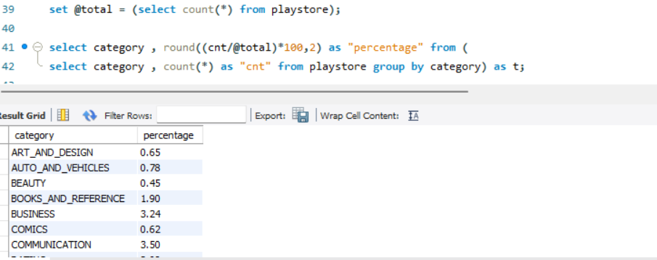
3. As a data analyst for a gaming company, you're tasked with calculating the percentage of games within each category. This information will help the company understand the distribution of gaming apps across different categories.

Slide 12
4. Recommendations for App Development Strategy by Category
Objective Guide the company in deciding whether to develop paid or free apps for each category based on the average ratings. Result: Develop paid apps for ART_AND_DESIGN, AUTO_AND_VEHICLES, and BUSINESS (higher ratings for paid apps), and develop free apps for BOOKS_AND_REFERENCE and COMMUNICATION (higher ratings for free apps).
By following these recommendations, the company can maximize user satisfaction and potential revenue by focusing on the app types that have historically received better ratings within each category.

Slide 13
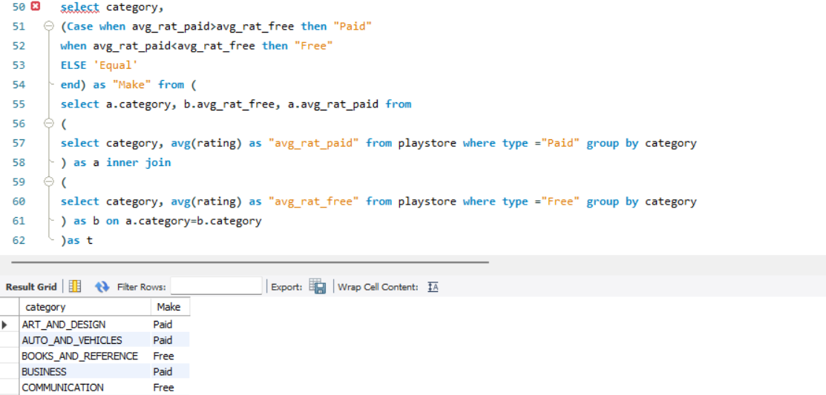
4. As a data analyst at a mobile app-focused market research firm you’ll recommend whether the company should develop paid or free apps for each category based on the ratings of that category.

Slide 14
5. Measure to Record Changes in App Prices During a Database Hack
Objective: Implement a measure to log all price changes of apps to track unauthorized modifications during a hacking incident.
Result : Create a `PriceChangeLog` able to store app name, old price, new price, operation type, and timestamp of changes. Make a copy of the original table (`play`) and create a trigger to log price updates into the `PriceChangeLog` table. For example, updating the price of an app `Infinite Painter` will be logged automatically. Verify logged changes by querying the `PriceChangeLog` table.
By implementing this logging mechanism, the database administrator can effectively monitor and record unauthorized price changes during a hack, ensuring data integrity and providing a detailed change history.

Slide 15
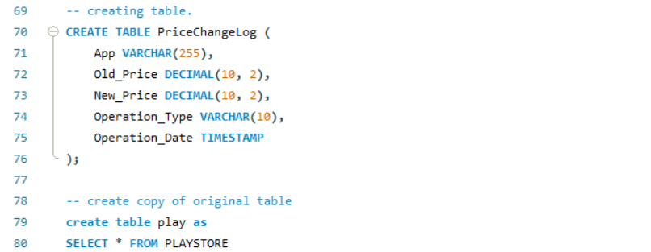
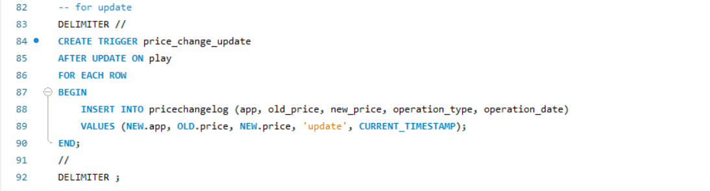
5. Suppose you're a database administrator your databases have been hacked and hackers are changing price of certain apps on the database, it is taking long for IT team to neutralize the hack, however you as a responsible manager don’t want your data to be changed, do some measure where the changes in price can be recorded as you can’t stop hackers from making changes.

Slide 16
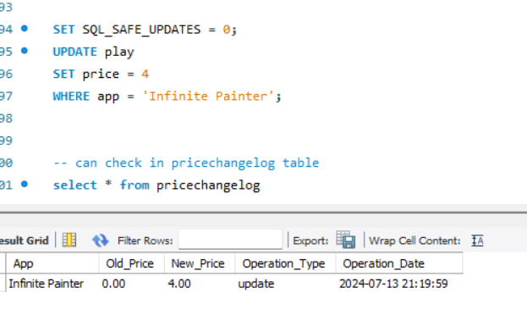

Slide 17
6. Correcting Price Data in Database
Objective: Revert prices in the `play` table to their original values as recorded before unauthorized changes.
Result: The following SQL query will update the `play` table to reflect the correct prices based on the `PriceChangeLog` table. By executing this query, the `play` table will have its prices corrected to the values stored before the unauthorized changes, ensuring data accuracy and integrity.

Slide 18
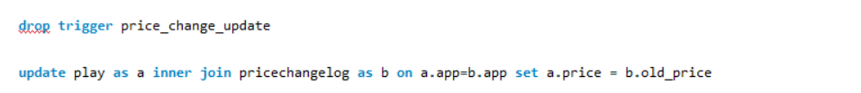
6. Your IT team have neutralized the threat; however, hackers have made some changes in the prices, but because of your measure you have noted the changes, now you want correct data to be inserted into the database again.

Slide 19
7. Investigating the Correlation Between App Ratings and Quantity of Reviews
Objective: Determine the Pearson correlation coefficient between app ratings and the number of reviews to understand their relationship.
Result: The correlation coefficient, as calculated in the query, is `0.07`, indicating a very weak positive linear relationship between app ratings and the quantity of reviews.

Slide 20
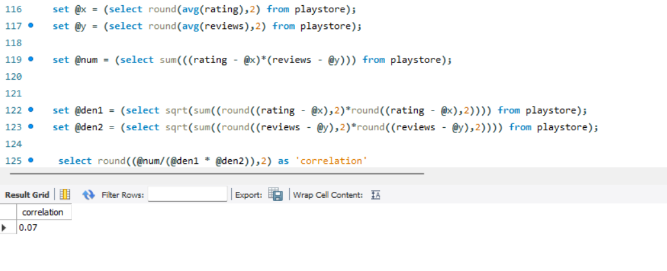
7. As a data person you are assigned the task of investigating the correlation between two numeric factors: app ratings and the quantity of reviews.

Slide 21
8. Cleaning the `genres` Column for Recommender System Development
Objective: To clean the `genres` column by splitting multiple genres into two separate columns, leaving the second column blank for rows with only one genre.
Result: The `genres` column was successfully split into two columns: `genre 1` for the first genre and `genre 2` for the second genre, with the second column left blank for single-genre rows. This cleaning process ensures that each genre is individually accessible, improving the accuracy and efficiency of the recommender system.

Slide 22
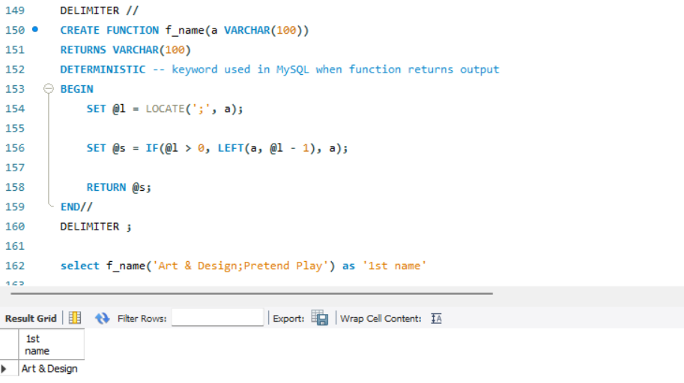
8. Your boss noticed that some rows in genres columns have multiple genres in them, which was creating issue when developing the recommender system from the data he/she assigned you the task to clean the genres column and make two genres out of it, rows that have only one genre will have other column as blank.

Slide 23
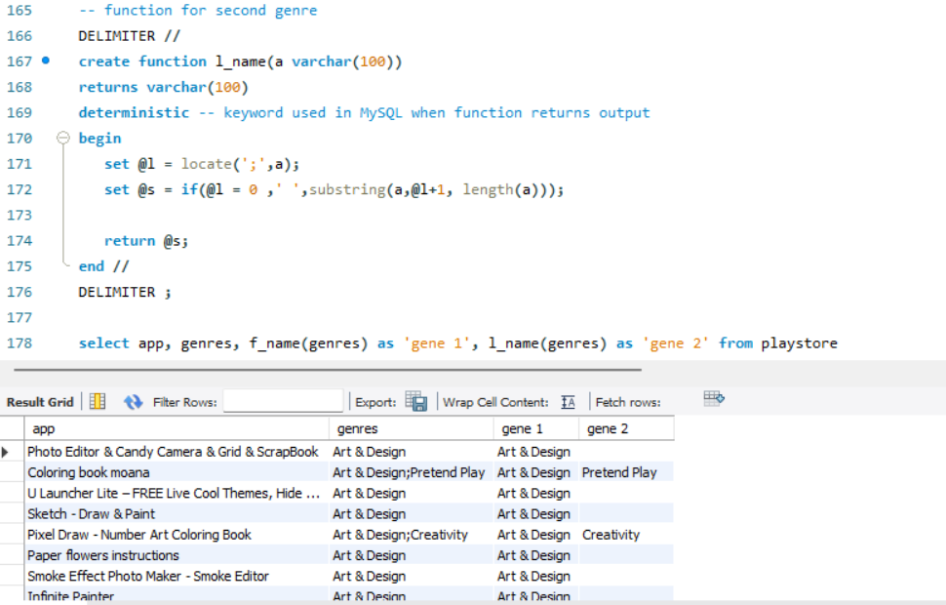

Slide 24
9. Dynamic Tool for Identifying Underperforming Apps by Category
Objective: Create a dynamic tool that allows senior management to input an app category and receive real-time feedback on apps with ratings lower than the average for that category. Result: The tool enables users to identify underperforming apps in any specified category by displaying apps with below-average ratings, providing quick and actionable insights for decision-making.

Slide 25
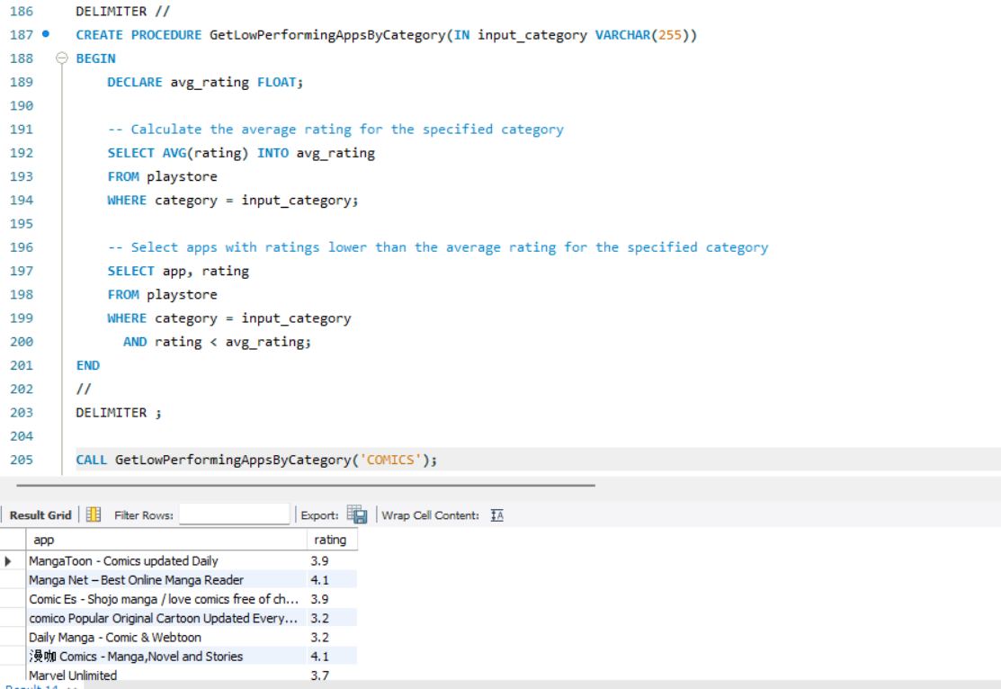
9. Your senior manager wants to know which apps are not performing as par in their particular category, however he is not interested in handling too many files or list for every category and he/she assigned you with a task of creating a dynamic tool where he/she can input a category of apps he/she interested in and your tool then provides real-time feedback by displaying apps within that category that have ratings lower than the average rating for that specific category.

